Slide 1


Proof of Concept Model
Innovation Sandbox Framework
Stanbic Bank Zambia Limited

Slide 2
Ownership Statement
This Proof of Concept (PoC) framework, meticulously crafted by Innovation Village for Stanbic Bank Zambia Limited, is the exclusive intellectual property of Stanbic Bank Zambia Limited.
All elements comprising this framework, encompassing its methodologies, processes, and documentation, are the proprietary assets of Stanbic Bank Zambia Limited. Unauthorized replication, dissemination, or utilization of this framework without explicit written consent from Stanbic Bank Zambia Limited is strictly prohibited.
Stanbic Bank Zambia Limited reserves the right to uphold its intellectual property rights to the fullest extent permissible by law.

Slide 3
Background
In today's rapidly evolving business landscape, corporate innovation has emerged as a crucial driver of growth and sustainability, particularly within the financial services sector. As customer expectations continue to evolve, financial organizations are under increasing pressure to deliver innovative products and services that cater to changing market demands.
However, despite the clear imperative for innovation, many financial institutions grapple with internal processes, governance structures, and regulatory limitations that hinder their ability to swiftly bring new ideas to market Complex approval procedures and regulatory compliance requirements slow down innovation pipelines, posing challenges for organizations striving to stay competitive. Streamlining innovation frameworks and adopting agile methodologies are crucial for overcoming these barriers and accelerating time-to-market for transformative innovations.
Purpose and Scope
The product development framework and Proof of Concepts (PoCs) are instrumental in driving innovation initiatives within Stanbic Bank Zambia, focusing on business improvement, optimization, and market disruption.
The scope encompasses the design, development, and integration of novel solutions aligned with the bank's digital and innovation strategy.
This document is instructional and accompanied with working tools to guide the implementation of the frameworks designed to enable speed to market, effective assessment and valuation of projects for benefit realization.
Methodology
The framework outlines a structured approach to product development, leveraging internal data insights and customer feedback for validation. Methodologies for product design, development, and testing adhere to the bank's security and data management protocols, ensuring compliance and reliability.
Benefits
The framework will facilitate the acceleration of time-to-market for innovative solutions, enabling Stanbic Bank Zambia to swiftly respond to market demands and stay ahead of competitors.
The framework will enhance operational efficiency, foster customer satisfaction, and supports strategic objectives related to business optimization and market disruption.

Slide 4
Product Development Framework: High-Level Worfklow
Channel Awareness
Data Capture
Process Data
Opportunity Evaluation
Validation & Prioritization
Re-integration to Business
Test & Iterations
POC Development
Approval from Digital Forum
Business Case Development
Approval of POC

Slide 5





Idea Collection Sources
There will be four sources of ideas and user stories.
The goal to make idea collection a continuous exercise that runs in the organization all year round.
As a (stakeholder)…,
I want to (task)…,
So that (desired result)…,
Incident
Reports
Innovation Programs
e.g. Hackathons
Strategic Business
Decisions
Digital Suggestion Box &
Customer Feedback

Slide 6
Capturing User Stories
User stories and ideas will be captured using a form designed and hosted on a portal.
Ideas and user stories from incident reports and business strategic decisions will be generated by internal personnel/staff.
Ideas from innovation programs such as hackathons will be generated both from staff at staff hackathons and externally from innovators during open innovation programs and competitions Digital Suggestion Boxes will be hosted on the company´s website with QR Codes displayed across the physical branches and digital channels to allow customers to submit their user stories.
As a (stakeholder)…,
I want to (task)…,
So that (desired result)…,

Slide 7
Category | Criteria
New Product/Service | Proposes a completely new offering or solution Addresses an unmet need or creates a new market opportunity. Demonstrates potential for significant business impact and revenue generation Requires substantial development effort and resources.
New Product/Service Feature | Enhances or adds to an existing product or service Improves user experience, functionality, or performance. Builds upon existing infrastructure or technology. Offers value-added features or capabilities to existing customers.
New Process | Introduces a novel approach or methodology to streamline operations. Improves efficiency, productivity, or cost-effectiveness. Enhances collaboration or communication within the organization. Aligns with strategic objectives and business goals.
Amendment/Update of Feature/Process Request | Seeks to modify or refine an existing product, service, or process. Addresses identified issues, gaps, or opportunities for improvement. Proposes incremental changes or updates based on user feedback or market trends. Aimed at optimizing performance, usability, or compliance with regulations.
Idea
Submission Assessment Criteria
Assign a team of dedicated business analysts to manually assess and categorize submissions into New Product/Service, New Product/Service Feature, New Process, or Amendment/Update of Feature/Process Request.
NB: The team of analysts can be assigned by the Innovation Village to oversee this process
[Click here to download the assessment tool]

Slide 8
Prioritization Framework:
Assessment Criteria for Scoring
Prioritization System Weighting Scale
Interpretation of Priority Score Ranges
Criteria | Description | Score (Out of 10)
Potential Impact on Business Objectives | The potential impact of the submission on achieving business objectives, including revenue growth, cost savings, and market expansion.
Feasibility and Resource Requirements | The feasibility of implementing the submission, considering resource availability, technical feasibility, and time constraints.
Alignment with Strategic Objectives | The extent to which the submission aligns with the organization's strategic goals and priorities.
Market Demand and Competitive Advantage | The level of market demand for the proposed solution and its ability to provide a competitive advantage over existing offerings.
Innovation and Differentiation | The degree of innovation and uniqueness of the submission compared to existing solutions in the market.
Criteria | Weight
Potential Impact on Business Objectives | 0.3
Feasibility and Resource Requirements | 0.2
Alignment with Strategic Objectives | 0.2
Market Demand and Competitive Advantage | 0.2
Innovation and Differentiation | 0.1
Score Range | Interpretation
9.0 - 10.0 | High Priority
7.0 - 8.9 | Significant Priority
5.0 - 6.9 | Moderate Priority
3.0 - 4.9 | Low Priority
1.0 - 2.9 | Very Low Priority
Explanation:
High Priority (9.0 - 10.0): Submissions falling within this range demonstrate outstanding potential impact, feasibility, alignment with strategic objectives, market demand, and innovation. These submissions should be given the highest priority for further development and implementation.
Significant Priority (7.0 - 8.9): Submissions in this range exhibit very positive attributes across all criteria, indicating strong potential for success and significant business impact. They should be considered for prioritization in the near term.
Moderate Priority (5.0 - 6.9): Submissions falling within this range show promise and merit further consideration. While they may not be as exceptional as higher-scoring submissions, they still demonstrate solid potential for success and moderate business impact.
Low Priority (3.0 - 4.9): Submissions in this range indicate average performance across the evaluation criteria. They may have some positive aspects but also areas for improvement. Consideration for prioritization should be based on available resources and strategic alignment.
Very Low Priority (1.0 - 2.9): Submissions scoring in this range exhibit significant weaknesses across multiple criteria and may have limited potential for success. They should be given low priority for further development, and resources may be better allocated to higher-priority initiatives.
Prioritization Score Calculation:
Priority Score = (Potential Impact * 0.3) + (Feasibility * 0.2) + (Alignment * 0.2) + (Market Demand * 0.2) + (Innovation * 0.1)
Example:
Suppose a submission for a New Product/Service has the following scores:
Potential Impact: 8/10
Feasibility: 7/10
Alignment: 9/10
Market Demand: 6/10
Innovation: 8/10
Priority Score = (8 * 0.3) + (7 * 0.2) + (9 * 0.2) + (6 * 0.2) + (8 * 0.1) = 2.4 + 1.4 + 1.8 + 1.2 + 0.8 = 7.6
Scoring Guidelines:
Score (Out of 10): Assign a score from 1 to 10 for each criterion, where 1 represents the lowest performance and 10 represents the highest performance.
Use qualitative and quantitative measures to assess each criterion objectively.
Consider using a standardized scoring rubric or guidelines to ensure consistency in evaluation across submissions.
Collaborate with relevant stakeholders to gather input and insights when scoring each criterion.
Ensure that scoring reflects the relative importance of each criterion as per the assigned weightings.
[Click here to Download the prioritization tool]

Slide 9
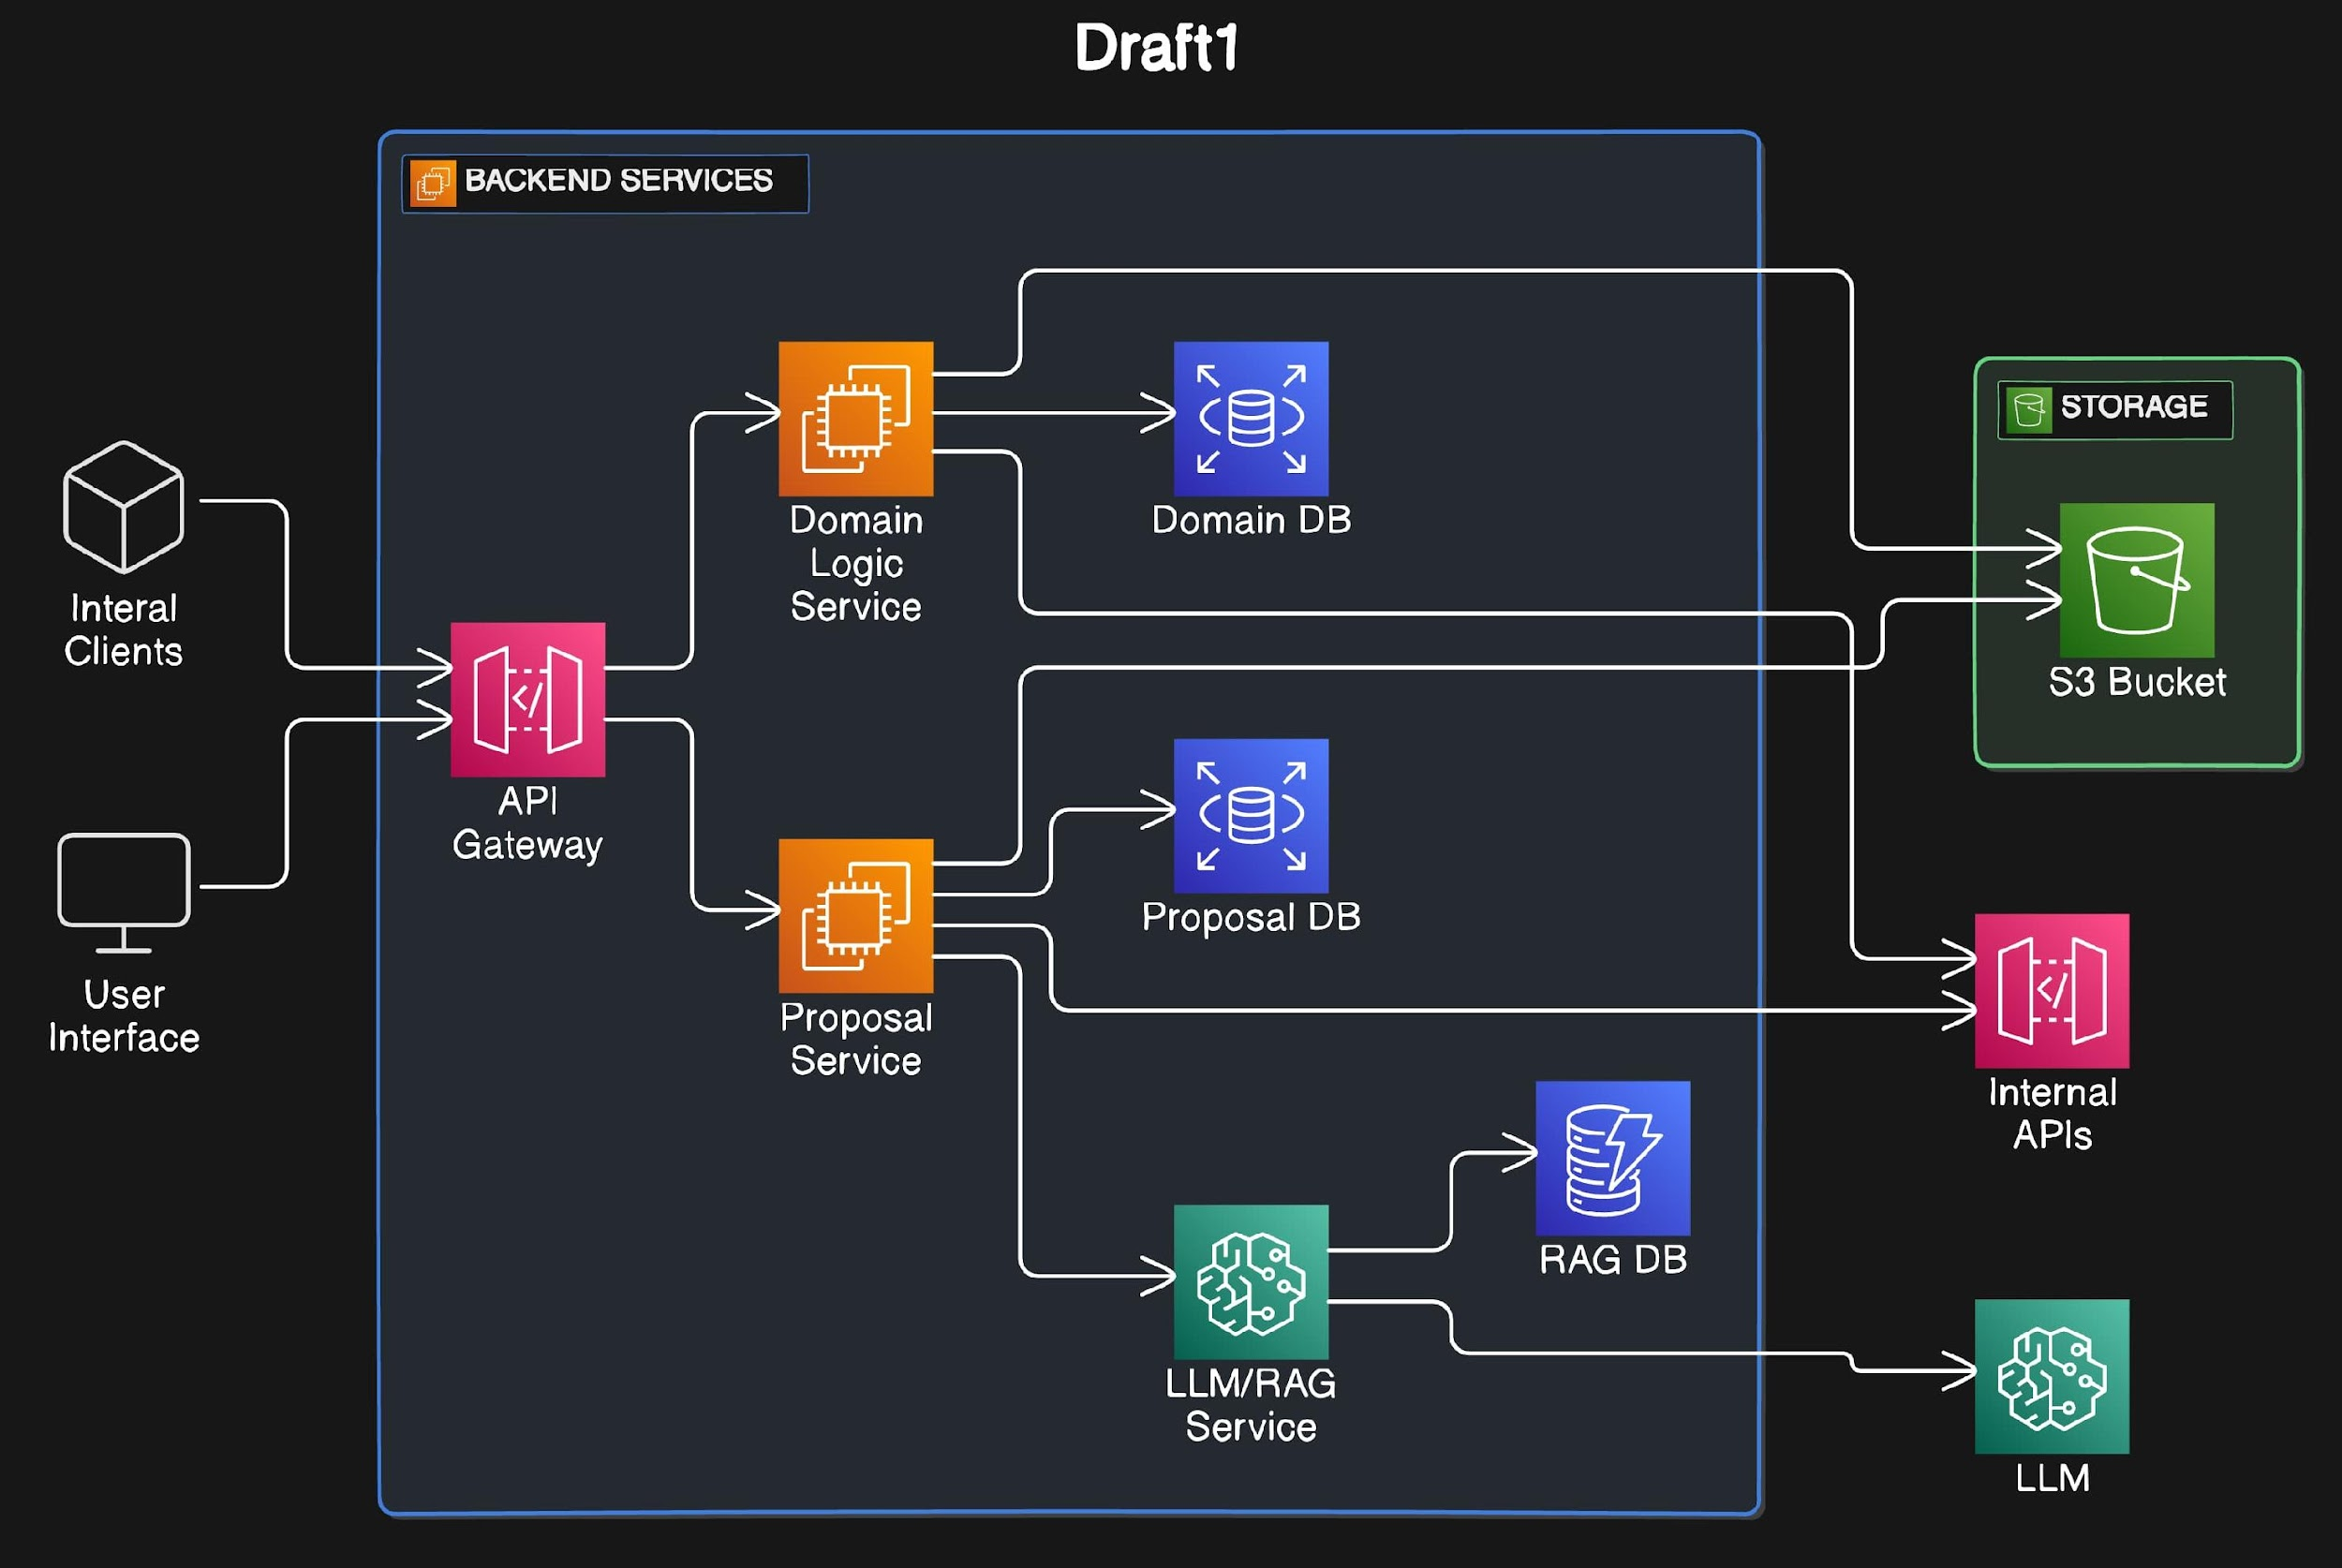
Proposed System Architecture (Cloud Hosting)

Slide 10
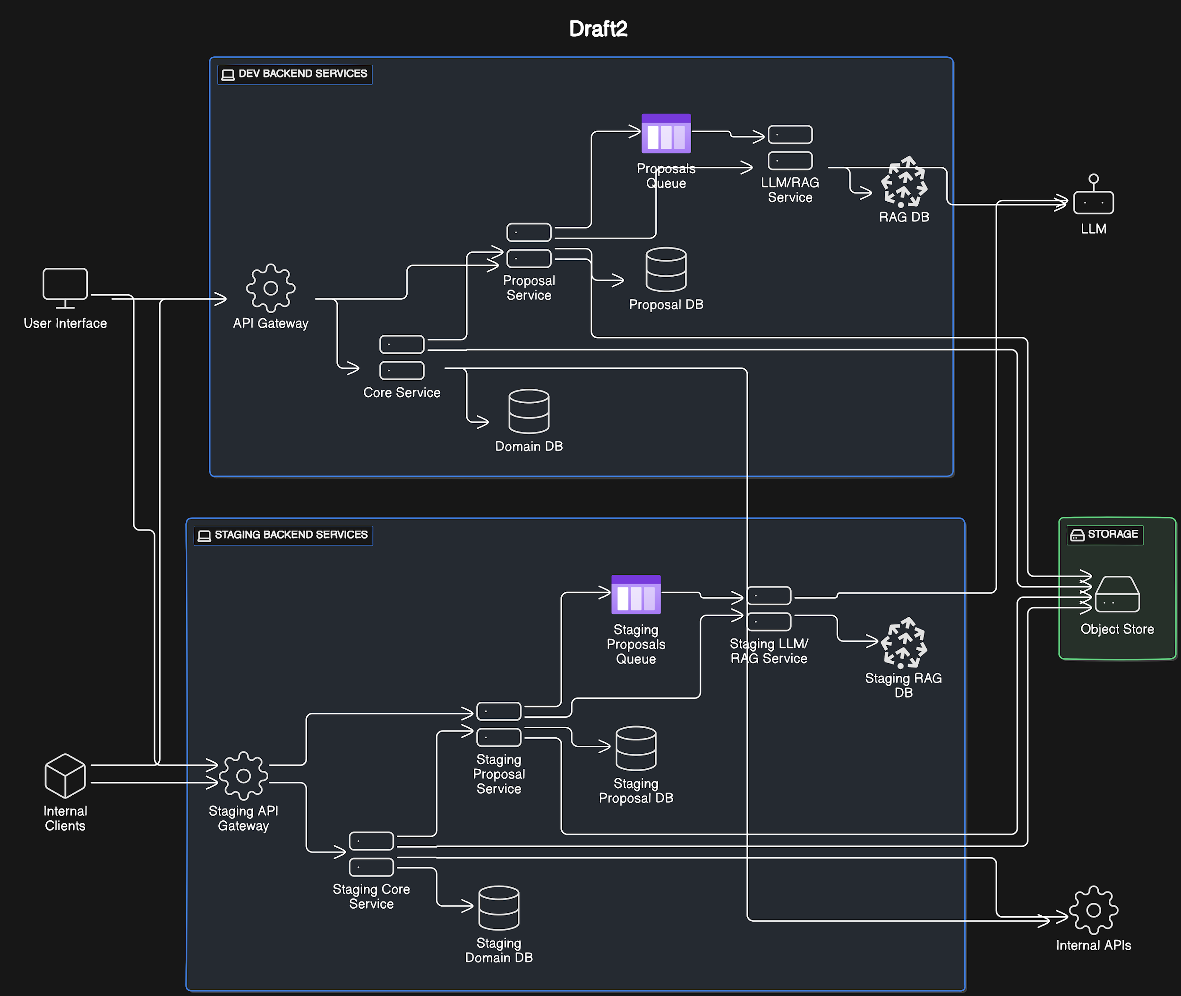
Proposed System Architecture (On-Prem Hosting)

Slide 11
Benefit Realization Framework for PoC Proposals
Thematic Area | Description
Client Satisfaction | Measure improvements in customer satisfaction metrics, such as Net Promoter Score (NPS) or Customer Satisfaction Index (CSI).
Client Growth | Evaluate the impact of the PoC on acquiring new clients, increasing market share, and expanding customer base.
Client Offering | Assess enhancements to client offerings, including new products/services, features, or customization options.
Client Engagement | Analyze improvements in client engagement metrics, such as customer retention rates, frequency of interactions, and cross-selling success.
Workforce Productivity | Measure the efficiency gains and productivity improvements achieved by employees as a result of the PoC implementation.
Regulatory Compliance | Ensure adherence to regulatory requirements and assess the effectiveness of compliance measures implemented through the PoC.
Always On/Always Secure | Evaluate the reliability and security enhancements achieved through the PoC, ensuring continuous availability and data protection.
Future-proof Systems | Assess the scalability, adaptability, and resilience of systems implemented in the PoC to meet future business needs and technological advancements.
Improved Efficiency | Quantify the efficiency gains and cost savings realized through process optimization, automation, or resource utilization improvements.
Revenue Growth | Measure the impact of the PoC on revenue generation, including increases in sales, revenue per client, and overall revenue growth.
Revenue Defence | Evaluate the PoC's effectiveness in mitigating revenue loss, minimizing churn, and defending against competitive threats.
How to implement the framework for ROI tracking
Define Key Performance Indicators (KPIs): Identify specific metrics and KPIs for each thematic area to measure the desired outcomes.
Baseline Assessment: Establish baseline measurements for each KPI to provide a benchmark for evaluating the PoC's impact.
PoC Implementation: Execute the PoC according to the proposed solution, ensuring alignment with the identified thematic areas and objectives.
Monitoring and Evaluation: Continuously monitor the performance of the PoC against the established KPIs, collecting relevant data and feedback.
Benefit Analysis: Analyze the collected data to assess the realized benefits and impacts of the PoC across the thematic areas.
Reporting and Communication: Prepare comprehensive reports summarizing the findings and insights gained from the benefit realization analysis.
Iterative Improvement: Use the insights gained to refine and optimize future PoC proposals, ensuring continuous improvement and alignment with strategic objectives.
[Click here to Download the PoC Benefit realization tool]

Slide 12
Data Management Protocols for POCs
Protocol | Description
Anonymization | Implement anonymization techniques to replace personally identifiable information (PII) with non-identifying placeholders or pseudonyms in datasets used for POCs.
Data Minimization | Minimize the collection and retention of sensitive data to only what is necessary for the POC's objectives, reducing the risk exposure and compliance requirements associated with handling large volumes of data.
Use of Dummy Data | Utilize dummy data or synthetic datasets that mimic the characteristics and structure of real data but do not contain any actual sensitive information, ensuring privacy and security during testing and development phases.
Encryption | Encrypt sensitive data at rest and in transit within the POC environment to safeguard confidentiality and prevent unauthorized access or interception by unauthorized parties.
Access Controls | Implement strict access controls and role-based permissions to restrict access to sensitive data within the POC environment, ensuring that only authorized personnel can view or manipulate data as needed.
Data Masking | Apply data masking techniques to obscure sensitive information in datasets used for testing or development purposes, allowing authorized users to work with realistic data while protecting individuals' privacy and confidentiality.
Secure Data Disposal | Develop procedures for secure data disposal, including the deletion or anonymization of data no longer needed for the POC, to prevent unauthorized access or accidental exposure of sensitive information.
Compliance Monitoring | Monitor data management practices within the POC environment to ensure compliance with relevant data protection regulations (e.g., GDPR, CCPA) and internal security policies governing the handling of sensitive data.
Data Ownership | Clearly define data ownership and responsibility within the POC environment, specifying who is accountable for managing, protecting, and maintaining the integrity of data throughout its lifecycle within the project.
Audit Trails | Maintain detailed audit trails and logs of data access, manipulation, and transactions within the POC environment, enabling traceability and accountability in the event of security incidents or data breaches.

Slide 13
Stakeholder Engagement: Product & Problem Validation |Insight Collection Guide
Step | Description
Conduct Focus Groups | Organize focus group sessions with selected customers to gather in-depth insights and opinions on proposed solutions.
 | Facilitate structured discussions to explore customer preferences, pain points, and expectations related to the proposed products.
 | Encourage open dialogue and active participation to uncover valuable feedback and perspectives.
 | Document key insights, observations, and themes emerging from the focus group discussions.
Conduct Surveys | Design and administer surveys targeting a broader audience to gather quantitative data on product concepts and problem statements.
 | Use survey tools and platforms to reach a diverse range of customers and collect feedback efficiently.
 | Include targeted questions to assess customer preferences, satisfaction levels, and willingness to adopt proposed solutions.
 | Analyze survey responses to identify trends, patterns, and areas of consensus or divergence among respondents.
Conduct Interviews | Conduct one-on-one interviews with selected customers to delve deeper into specific issues, concerns, or opportunities identified.
 | Customize interview questions to explore individual experiences, preferences, and insights relevant to the proposed solutions.
 | Listen actively to participant responses, probing for detailed explanations and uncovering nuanced perspectives.
 | Capture detailed notes and observations during interviews to capture valuable insights and identify common themes or pain points.
Validate Product Concepts | Validate proposed product concepts and problem statements with target audience segments to ensure alignment with market needs.
 | Present prototypes, mock-ups, or concept designs to solicit feedback and gauge initial reactions from customers.
 | Encourage participants to provide constructive feedback on usability, functionality, and overall appeal of the proposed solutions.
 | Iteratively refine product concepts based on customer insights and feedback to enhance product-market fit and alignment with needs.

Slide 14
Stakeholder Engagement: Product & Problem Validation | Segmentation Framework
Criteria | Description
Demographic | Characteristics such as age, gender, income, education level, occupation, marital status, and location.
Psychographic | Lifestyle, values, attitudes, interests, hobbies, personality traits, behaviour patterns, and opinions.
Behavioural | Purchasing behaviour, usage patterns, brand loyalty, product/service preferences, buying frequency, purchase occasion, and benefits sought.
Geographic | Location-based segmentation, including region, country, city size, climate, population density, urban/rural classification, and time zone.
Firmographic | Business-specific characteristics, including industry sector, company size, annual revenue, number of employees, location, and organizational structure.
Technographic | Technology-related attributes, such as software/hardware usage, adoption of emerging technologies, digital proficiency, and preferred communication channels.
Socioeconomic | Socioeconomic status, including income level, occupation prestige, educational attainment, and social class.

Slide 15
Stakeholder Engagement: Product & Problem Validation |Workflow
Identify Stakeholders
Define Objectives
Segmentation
Engagement Channels
Feedback Collection
Iterative Refinement
Analysis and Insights

Slide 16
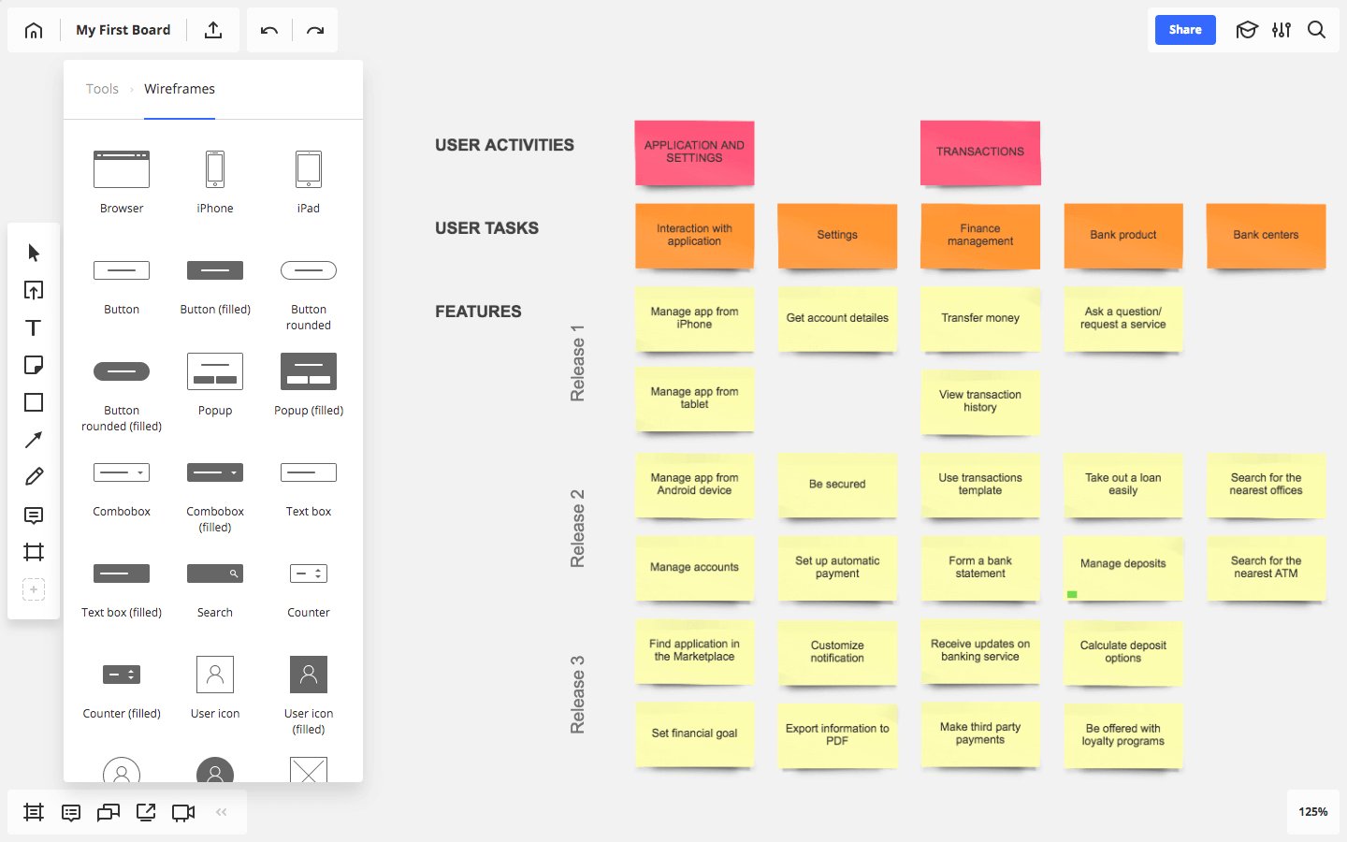
Sprint Planning The Proof of Concept (PoC)

Slide 17
Protocols for Logging Issues, Requests, Feedback, and Changes
Following these protocols ensures systematic documentation, tracking, and management of issues, requests, feedback, and changes throughout the program management process, facilitating effective communication, collaboration, and decision-making
Category | Protocol
Issue Logging | Use JIRA as the primary platform for logging and tracking issues.
 | Provide detailed descriptions, including problem descriptions, impact, priority levels, and relevant attachments or screenshots.
 | Assign issues to appropriate team members and regularly update their status for timely resolution.
Request Logging | Log all change requests, enhancements, or additional resource requests in JIRA.
 | Clearly define the request's purpose, desired outcome, and assign it to responsible team members.
 | Regularly review and prioritize requests based on their impact, urgency, and alignment with project objectives.
Feedback Logging | Capture feedback within Confluence, creating dedicated spaces for documentation and discussion.
 | Encourage stakeholders to provide clear, constructive feedback on project components or phases.
 | Analyze feedback regularly to identify common themes and actionable insights for project improvements.
Change Logging | Document all changes to project scope, requirements, or deliverables within JIRA.
 | Clearly articulate the rationale behind each change and involve relevant stakeholders in the evaluation and approval process.
 | - Maintain a comprehensive change log within JIRA to track the history of changes made throughout the project lifecycle.

Slide 18
Considerations for Sandbox Environments for POCs
Consideration | Description
Isolation | Ensure sandbox environments are isolated from production systems to prevent unintended impacts on live operations or sensitive data.
Network Segmentation | Implement network segmentation to restrict communication between the sandbox environment and other organizational networks, minimizing the risk of unauthorized access.
Data Privacy | Anonymize or pseudonymize sensitive data used in sandbox environments to protect customer privacy and comply with data protection regulations (e.g., GDPR, CCPA).
Access Controls | Implement stringent access controls and role-based permissions to restrict access to sandbox environments to authorized personnel only.
Data Encryption | Encrypt data at rest and in transit within sandbox environments to safeguard sensitive information from unauthorized access or interception.
Monitoring and Logging | Deploy robust monitoring and logging mechanisms to track user activities, system events, and data access within sandbox environments for security auditing and incident response.
Regular Refresh | Periodically refresh sandbox environments with clean datasets and configurations to maintain consistency and integrity for testing and experimentation purposes.
Compliance and Governance | Ensure sandbox environments adhere to internal security policies, regulatory requirements, and industry standards governing data privacy and security.
Microservices Architecture | Implement containerization and microservices architecture to modularize components of the bank's systems, facilitating agility, scalability, and isolation within sandbox environments.
Version Control | Maintain version control for software and configurations deployed in sandbox environments to track changes, rollback updates, and ensure consistency across iterations.
Disaster Recovery | Develop disaster recovery plans and backup procedures to recover sandbox environments in the event of system failures, data corruption, or other unforeseen incidents.

Slide 19
IT Security Considerations for Sandbox Environments
Consideration | Description
Isolation | Ensure sandbox environments are fully isolated from production systems to prevent any potential impact on live operations or sensitive data.
Network Segmentation | Implement strict network segmentation to restrict communication between the sandbox environment and the rest of the bank's infrastructure, minimizing the risk of unauthorized access.
Data Privacy | Anonymize or pseudonymize sensitive data used within sandbox environments to protect customer privacy and comply with data protection regulations (e.g., GDPR, CCPA).
Access Controls | Enforce robust access controls and role-based permissions to limit access to sandbox environments only to authorized personnel.
Data Encryption | Utilize encryption techniques to protect data at rest and in transit within sandbox environments, ensuring confidentiality and integrity of sensitive information.
Monitoring and Logging | Implement comprehensive monitoring and logging mechanisms to track user activities, system events, and data access within sandbox environments for auditing and incident response.
Regular Refresh | Periodically refresh sandbox environments with sanitized data and configurations to maintain consistency and integrity for testing and experimentation purposes.
Compliance and Governance | Ensure that sandbox environments comply with internal security policies, regulatory requirements, and industry standards governing data protection and security.
Microservices Architecture | Apply containerization and microservices architecture to segment and modularize components within sandbox environments, enhancing agility and scalability while maintaining isolation.
Version Control | Establish version control for software and configurations deployed in sandbox environments to manage changes, rollback updates, and ensure consistency across iterations.
Disaster Recovery | Develop and test disaster recovery plans and backup procedures to facilitate quick recovery of sandbox environments in the event of system failures or data breaches.

Slide 20
User Acceptance Test (UAT) Protocols
Protocol | Description
Test Planning | Develop a comprehensive test plan outlining the scope, objectives, and approach for UAT activities, including test scenarios, test cases, and acceptance criteria to ensure thorough testing coverage.
Test Environment | Set up a dedicated UAT environment that closely mirrors the production environment, providing testers with an accurate representation of the system and its functionalities to validate real-world scenarios effectively.
Stakeholder Involvement | Involve key stakeholders, including business users, subject matter experts, and project sponsors, in UAT activities to ensure alignment with business requirements, validate user expectations, and gather valuable feedback for refinement.
Test Data Preparation | Prepare representative and relevant test data sets to simulate various user scenarios, business processes, and system interactions during UAT, ensuring that testers have access to realistic data for thorough validation of system functionality.
Test Execution | Execute test cases and scenarios based on the defined test plan, following structured procedures and methodologies to systematically validate system behavior, identify defects, and ensure compliance with business requirements and user expectations.
Defect Management | Establish a robust defect management process to track, prioritize, and resolve issues identified during UAT, including capturing detailed defect reports, assigning ownership, and facilitating timely resolution and retesting of defects until closure.
User Training | Provide training sessions and user documentation to familiarize testers with the system's features, functionalities, and UAT procedures, ensuring that they have the necessary knowledge and skills to perform testing effectively and provide meaningful feedback.
Acceptance Criteria | Define clear acceptance criteria and success metrics for UAT, aligning with business objectives and requirements to determine when the system meets user expectations and is ready for production deployment.
Communication | Maintain open and transparent communication channels throughout the UAT process, including regular progress updates, status reports, and stakeholder meetings to ensure alignment, address concerns, and facilitate timely decision-making and issue resolution.
Regression Testing | Conduct regression testing to validate that system changes and enhancements introduced during development or bug fixes do not adversely impact existing functionalities or introduce new defects, ensuring the overall stability and integrity of the system.
Sign-Off | Obtain formal sign-off from stakeholders and business users confirming their acceptance of the system's functionality, performance, and readiness for production deployment, acknowledging that the system meets their expectations and fulfills business requirements.

Slide 21
Risk Categorization
Risk Category | Description | Examples
Technical Risks | Risks related to technical complexities, limitations, or failures during POC implementation. | Integration issues, software bugs, hardware malfunctions, compatibility issues.
Operational Risks | Risks associated with operational processes, procedures, and resources required for POC execution. | Insufficient resources, inadequate training, lack of stakeholder engagement, poor project management.
Financial Risks | Risks related to budgeting, funding, and financial management of POC projects. | Cost overruns, budget constraints, inaccurate cost estimates, unexpected expenses.
Legal and Regulatory Risks | Risks arising from non-compliance with laws, regulations, or industry standards applicable to POC initiatives. | Data privacy violations, intellectual property infringement, regulatory penalties.
Market Risks | Risks associated with market conditions, competition, and customer acceptance of POC solutions. | Lack of market demand, changes in consumer preferences, competitive pressures.
Strategic Risks | Risks impacting the alignment of POC projects with organizational objectives, goals, and strategies. | Misalignment with business priorities, failure to achieve strategic objectives, deviation from corporate strategy.
External Risks | Risks originating from external factors beyond the organization's control, such as environmental, geopolitical, or economic factors. | Natural disasters, political instability, economic downturns, supply chain disruptions.
Reputational Risks | Risks affecting the organization's reputation, brand image, and public perception due to POC outcomes or handling. | Negative publicity, customer dissatisfaction, loss of trust and credibility.
Security Risks | Risks related to the security and protection of data, information, and assets involved in POC projects. | Data breaches, cyberattacks, unauthorized access, vulnerabilities in systems or infrastructure.
Environmental Risks | Risks associated with environmental impacts and sustainability considerations of POC activities. | Environmental pollution, resource depletion, ecological damage.

Slide 22
TOOLS & CONSIDERATIONS FOR THE POC MANAGEMENT
Tool/Consideration | Description
Project Management Software | Utilize project management tools such as JIRA, Trello, or Asana to track POC progress, manage tasks, assign responsibilities, and facilitate collaboration among team members.
Collaboration Platforms | Use collaboration platforms like Microsoft Teams, Slack, or Zoom for real-time communication, file sharing, and virtual meetings to foster collaboration and coordination among project stakeholders, ensuring efficient information exchange and decision-making.
Version Control Systems | Implement version control systems such as Git or SVN to manage codebase versions, track changes, and facilitate collaboration among developers working on POC development, ensuring code integrity, traceability, and easy rollback of changes if needed.
Cloud Infrastructure | Leverage cloud computing platforms like AWS, Microsoft Azure, or Google Cloud Platform to provision scalable and cost-effective infrastructure resources for hosting POC environments, enabling rapid deployment, flexibility, and scalability to support development and testing needs.
Analytics and Reporting | Employ analytics and reporting tools like Google Analytics, Tableau, or Power BI to gather insights, analyze data, and generate reports on POC performance, user engagement, and key metrics, enabling data-driven decision-making and evaluation of POC effectiveness.
Test Automation Tools | Use test automation tools such as Selenium, JUnit, or Postman for automating POC testing processes, including unit tests, integration tests, and regression tests, to improve testing efficiency, coverage, and reliability, ensuring the quality and stability of POC implementations.
Documentation Platforms | Utilize documentation platforms like Confluence, Google Docs, or Microsoft SharePoint to create and maintain project documentation, including requirements documents, design specifications, user manuals, and technical documentation, ensuring clarity, consistency, and accessibility of project information.
Feedback Collection Systems | Implement feedback collection systems such as online surveys, feedback forms, or customer feedback portals to gather feedback from stakeholders, end-users, and customers on POC features, usability, and performance, enabling continuous improvement and refinement of POC solutions based on user input.
Security and Compliance Tools | Employ security and compliance tools such as vulnerability scanners, security monitoring systems, and compliance management platforms to ensure adherence to security best practices, regulatory requirements, and data protection standards throughout the POC lifecycle, safeguarding sensitive data and mitigating security risks.
Project Governance Framework | Establish a project governance framework outlining roles, responsibilities, and decision-making processes for POC management, including project charters, governance boards, and steering committees, to provide oversight, direction, and accountability for POC initiatives, ensuring alignment with organizational goals and objectives.

Slide 23

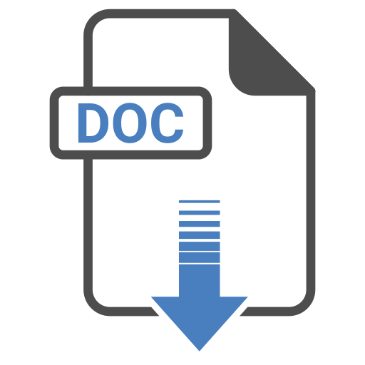
Templates
POC Governance
Templates

